Slide 1

2018 Seminar on Predictive Modeling: Open Source Tools and Data
Jeffrey Strickland, Ph.D., CMSP, ASEP
CEO Humalytica Analytics

Slide 2

The Imitation Game (2014)

Slide 3
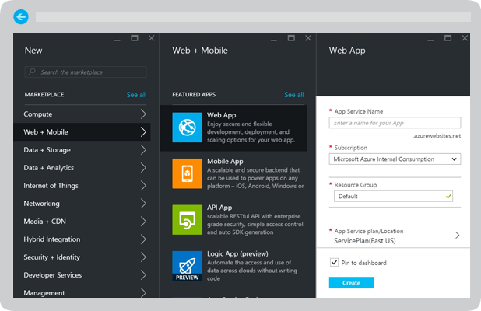
Data, Data, and More Data
Data Sources
Census Bureaus
Health Organizations
Google Analytics
Open Government Data (OGD) Platform India
Ministry of Statistics and Programme Implementation
Government Agencies
University Library Systems
Quandl
Indiastat.com
The World Bank
Data Services
Microsoft Azure
Google Web Services
Amazon Web Services

Slide 4


Web Data Services
Google Web Services
The created the Google Distributed File System (GDFS)
Google Analytics
Google Cloud Platform
Google Places API Web Service
Geocoding Web Service
Cloud Datastore – NoSQL
Cloud Machine Learning
BigQuery
Hadoop Integration
No GPU instance
https://cloud.google.com/
Microsoft Azure
Long history of data services
Master Data Services (MDS)
Microsoft SQL Server
Microsoft Access
Flexible Plans
App Service
Machine Learning
IoT Hub
Virtual Network
Azure Active Directory B2C
Data Lake Analytics
Hortonworks Sandbox

Slide 5


Web Data Services
AWS
Amazon Elastic MapReduce
Redshift (PB-Scale Data Warehouse)
Kinesis Analytics
DynamoDB
NoSQL database
Apache Hbase
QuickSight BI Service
Amazon Machine Learning
AWS Internet of Things (IoT) platform
Cloudera
IoT Service
Cyber Security Service
Hadoop Analytics
BI and SQL Analytics
Apache Impala
Apache Spark
Analytics and Operational DBs
Open Source Leadership
Automated Cluster Management
Cloudera Support

Slide 6
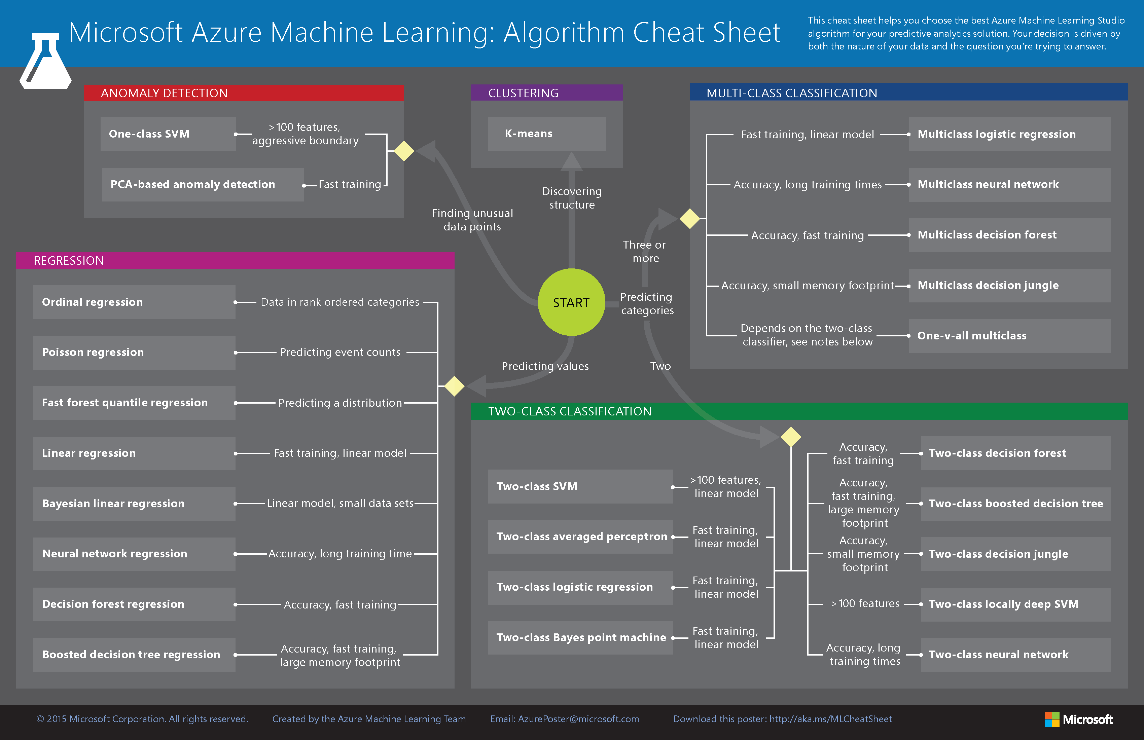
Machine Learning from Azure

Slide 7
Honorable Mentions
1010data
Actian Analytics Platform
HP HAVEn
IBM Big Data Platform
InfiniDB
Infobright
Kognitio
MapR
Oracle
Pivotal
SAP
Teradata

Slide 8

Hadoop is an open-source software framework for storing data and running applications on clusters of commodity hardware.
Allows to store and process big data in a distributed environment across clusters of computers using simple programming models.
It is designed to scale up from single servers to thousands of machines, each offering local computation and storage.

Slide 9
Where Did Hadoop Come From?
The genesis of Hadoop came from the Google File System paper [Ghemawat, Sanjay; Gobioff, Howard; Leung, Shun-Tak] that was published in October 2003.
This paper spawned another research paper from Google – MapReduce: Simplified Data Processing on Large Clusters. [Dean, Jeffrey; Ghemawat, Sanjay]
Development started in the Apache Nutch project, but was moved to the new Hadoop subproject in January 2006.
Doug Cutting, who was working at Yahoo! at the time, named it after his son's toy elephant.
The initial code that was factored out of Nutch consisted of 5k lines of code for Nutanix Distributed File System (NDFS) and 6k lines of code for MapReduce.
The first committer added to the Hadoop project was Owen O’Malley in March 2006.
Hadoop 0.1.0 was released in April 2006 and continues to evolve by the many contributors to the Apache Hadoop project.

Slide 10
What Comprises Hadoop?
The term Hadoop has come to refer not just to the base modules above, but also to the ecosystem, or collection of additional software packages that can be installed on top of or alongside Hadoop, such as:
Pig¹
Hive¹
HBase¹
Phoenix¹
Spark¹
ZooKeeper¹
MapReduce
Tez – Hindi for “speed”
HDFS
Cloudera Impala
Flume¹
Sqoop¹
Oozie¹
Storm¹
1. An Apache product

Slide 11
What are the Benefits of Hadoop?
Computing power: Its distributed computing model quickly processes big data. The more computing nodes you use, the more processing power you have.
Flexibility: Unlike traditional relational databases, you don’t have to preprocess data before storing it. You can store as much data as you want and decide how to use it later. That includes unstructured data like text, images and videos.
Fault tolerance: Data and application processing are protected against hardware failure. If a node goes down, jobs are automatically redirected to other nodes to make sure the distributed computing does not fail. And it automatically stores multiple copies of all data.
Low cost: The open-source framework is free and uses commodity hardware to store large quantities of data.
Scalability: You can easily grow your system simply by adding more nodes. Little administration is required.

Slide 12
References
Ghemawat, Sanjay; Gobioff, Howard; Leung, Shun-Tak. "The Google File System".
Dean, Jeffrey; Ghemawat, Sanjay. "MapReduce: Simplified Data Processing on Large Clusters".
Cutting, Doug (28 Jan 2006). "new mailing lists request: hadoop". issues.apache.org.The Lucene PMC has voted to split part of Nutch into a new sub-project named Hadoop

Slide 13
www.humalytica.com
http://www.amazon.com/Jeffrey-Strickland/e/B00IQ69QZK/
http://www.lulu.com/spotlight/strickland_jeffrey

